Slide 1
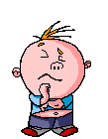
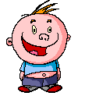
Who Wants To Be A Millionaire?
ENGLISH

Slide 2
Question 1

Slide 3
How old are you?
^{A} I nine years old
^{B} I’m nine year old
^{C} I’m nine years old
^{D} I’m nine years gold

Slide 4
How old are you?
^{A} I nine years old
^{B} I’m nine year old
^{C} I’m nine years old
^{D} I’m nine years gold
^{B} Boudicca
^{C} Julius Caesar
^{D} Bigus Headess

Slide 5
£100

Slide 6
Question 2

Slide 7

What’s the weather like today?
^{A} It’s cloudy
^{B} It cloudy
^{C} It’s claudy
^{D} It isn’t cloudy

Slide 8
What’s the weather like today?
^{A} It’s cloudy
^{B} It cloudy
^{C} It’s claudy
^{D} It isn’t cloudy
^{B} 43 BC
^{C} 43 AD
^{D} 55 AD

Slide 9
£200

Slide 10
Question 3

Slide 11

Where are you from?
^{A} I’m from Espain
^{B} I from Spain
^{C} I’m from Spain
^{D} I’m Spain

Slide 12
Where are you from?
^{A} I’m from Espain
^{B} I from Spain
^{C} I’m from Spain
^{D} I’m Spain
^{B} night
^{C} afternoon
^{D} evening
^{B} 62 AD
^{C} 43 AD
^{D} 11 AD

Slide 13
£300

Slide 14
Question 4

Slide 15
Where do you live?
^{A} I livein Socuellamos
^{B} I from Socuellamos
^{C} I’m Socuellamino
^{D} I live in Socuellamos

Slide 16
Where do you live?
^{A} I livein Socuellamos
^{B} I from Socuellamos
^{C} I’m Socuellamino
^{D} I live in Socuellamos
^{B} Anglos
^{C} Brits
^{D} Celts

Slide 17
£500

Slide 18
Question 5

Slide 19
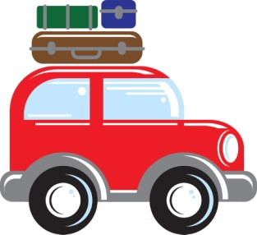
How do you come to school?
^{A} I walk to school
^{B} I come school by car
^{C} I come to schol by car
^{D} I come to school by car

Slide 20
How do you come to school?
^{A} I walk to school
^{B} I come school by car
^{C} I come to schol by car
^{D} I come to school by car
^{B} Towns
^{C} Villages
^{D} Settlements

Slide 21
£1,000

Slide 22
Question 6

Slide 23
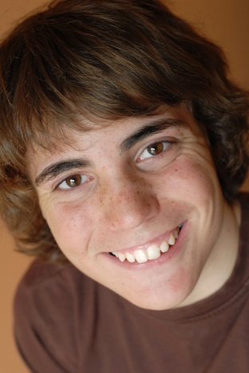
Have you got any brothers or sisters?
^{A I’ve got one sister}
^{B I’ve got one broder}
^{C} I’ve got one brother
^{D} I’ve got two brothers

Slide 24
Have you got any brothers or sisters?
^{A} ^{I’ve got one sister}
^{B I’ve got one broder}
^{C} I’ve got one brother
^{D} I’ve got two brothers
^{B} warmer climate
^{C} to expand their Empire
^{D slaves}

Slide 25
£2,000

Slide 26
Question 7

Slide 27
How many students are there in your class?
^{A} There are twenty students
^{B} There is twenty students
^{C} There are twenty teachers
^{D There are tuenty} students

Slide 28
How many students are there in your class?
^{A} There are twenty students
^{B} There is twenty students
^{C} There are twenty teachers
^{D There are tuenty} students

Slide 29
£4,000

Slide 30
Question 8

Slide 31
Have you got a cat?
^{A Yes, I do}
^{B} Yes, I can
^{C} Yes, I have
^{D} Yes, I havee

Slide 32
Have you got a cat?
^{A} ^{Yes, I do}
^{B} Yes, I can
^{C} Yes, I have
^{D} Yes, I havee
^{B} Bedalt
^{C} Boudicca
^{D} Beatrice

Slide 33
£8,000

Slide 34
Question 9

Slide 35
What is your favourite subject?
^{A} My favourite subject is Inglis
^{B} My favourite sabject is English
^{C} My favourite subject is English
^{D} My favourite subject is Englis

Slide 36
What is your favourite subject?
^{A} My favourite subject is Inglis
^{B} My favourite sabject is English
^{C} My favourite subject is English
^{D} My favourite subject is Englis

Slide 37
£16,000

Slide 38
Question 10

Slide 39
What do you do in your free time?
^{A} In my free time I like playing futbol
^{B} In my free time I like playing football
^{C} In my free time I laik playing football
^{D} In my free time I like play football

Slide 40
What do you do in your free time?
^{A} In my free time I like playing futbol
^{B} In my free time I like playing football
^{C} In my free time I laik playing football
^{D} In my free time I like play football

Slide 41
£32,000

Slide 42
Question 11

Slide 43
Is your house near the school?
^{A} No, it isent
^{B} No, it isen’t
^{C} No, it isnt
^{D} No, it isn’t

Slide 44
Is your house near the school?
^{A} No, it isent
^{B} No, it isen’t
^{C} No, it isnt
^{D} No, it isn’t

Slide 45
£64,000

Slide 46
Question 12

Slide 47
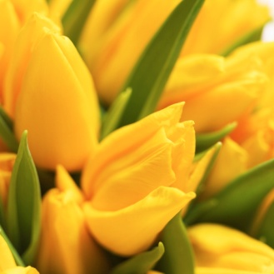
What is your favourite colour?
^{A} My favourite colour is yellow
^{B} My favourite color is yellow
^{C} My favourite colour is yelou
^{D} My feivrit colour is amarillo

Slide 48
What is your favourite colour?
^{A} My favourite colour is yellow
^{B} My favourite color is yellow
^{C} My favourite colour is yelou
^{D} My feivrit colour is amarillo

Slide 49
£125,000

Slide 50
Question 13

Slide 51
Which 2 of these are sports?
^{A} Football
^{B} Skate
^{C} Karate
^{D} Rollerblade

Slide 52
Which 2 of these are sports?
^{A} Football
^{B} Skate
^{C} Karate
^{D} Rollerblade
^{B} Cobnor Settlement
^{C} Bignor
^{D} Westhampnett

Slide 53
£250,000

Slide 54
Question 14

Slide 55
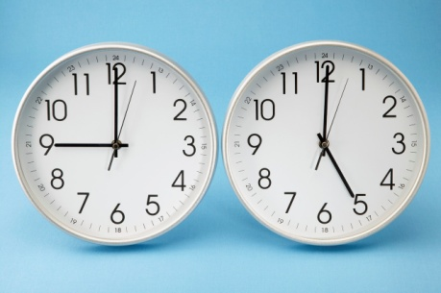
What time do you get up?
^{A} I get up at eight o’clock
^{B} I get up at eit o’clock
^{C} I get up in eight o’clock
^{D} I get up at eight oclock

Slide 56
What time do you get up?
^{A} I get up at eight o’clock
^{B} I get up at eit o’clock
^{C} I get up in eight o’clock
^{D} I get up at eight oclock

Slide 57
£500,000

Slide 58
Question 15

Slide 59
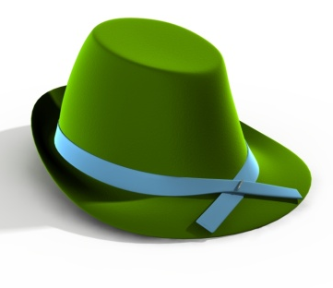
What are you wearing today?
^{A} I’m wearing a green hat
^{B} I’m wering a green hat
^{C} I’m wearing a grin hat
^{D} I’m waring a gren hat

Slide 60
What are you wearing today?
^{A} I’m wearing a green hat
^{B} I’m wering a green hat
^{C} I’m wearing a grin hat
^{D} I’m waring a gren hat

Slide 61
£1,000,000

